Slide 1
Physics Informed Neural Networks (PINNs)
Instructor: Mohammad Hasan
Office: 13-240
10/28/26
Notes:
Welcome and Introductions

Slide 2
Overview
PINNs and Physics Loss
PINNs for ODEs and PDEs
PINN Challenges and Potential Solutions

Slide 3
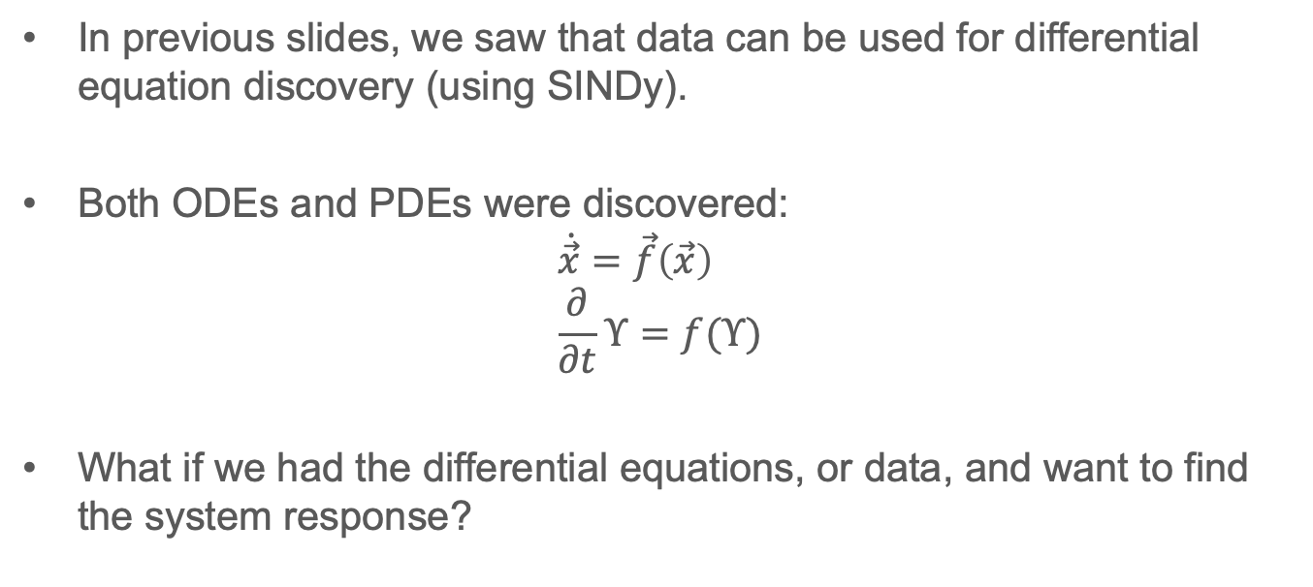
Time Response of Dynamical Systems
In previous slides, we saw that data can be used for differential equation discovery (using SINDy).
Both ODEs and PDEs were discovered:
$$\dot{\vec{x}}=\vec{f}\left(\vec{x}\right) \\ \frac{∂}{∂t}Υ=f(Υ)$$
What if we had the differential equations, or data, and want to find the system response?

Slide 4
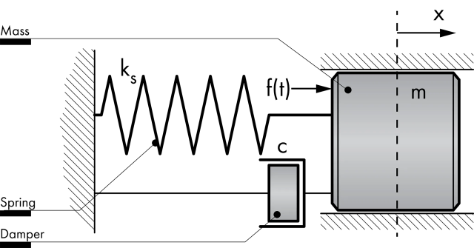
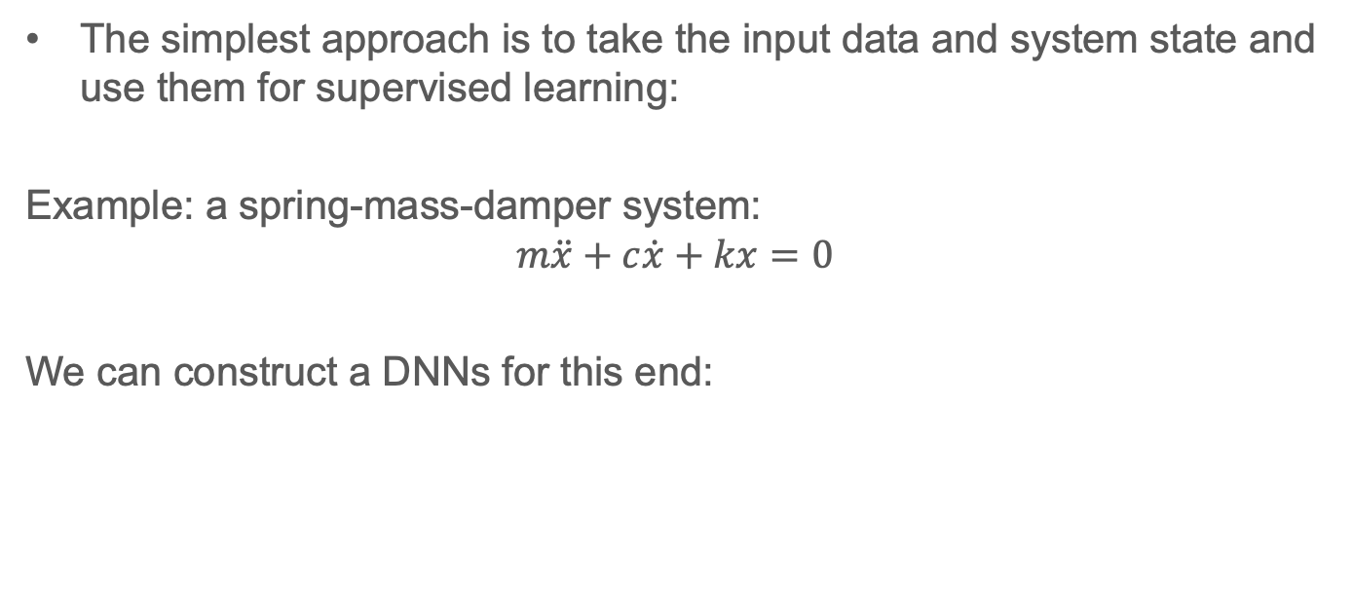
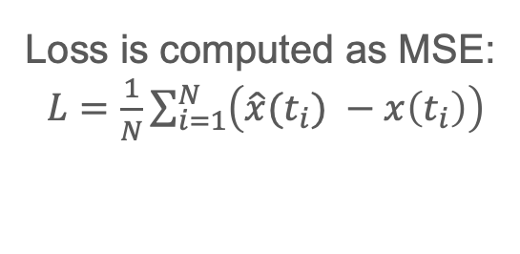


Supervised Learning
The simplest approach is to take the input data and system state and use them for supervised learning:
Example: a spring-mass-damper system:
$$m\ddot{x}+c\dot{x}+kx=0$$
We can construct a DNNs for this end:
Loss is computed as MSE:
$L=\frac{1}{N}\sum_{i=1}^{N}{\left(\hat{x}(t_{i}) −x\left(t_{i}\right)\right)}$
$$t_{i}$$
$$\hat{x}(t_{i})$$
The more complex the differential equation → The deeper NN needed → The more experimental data needed…

Slide 5
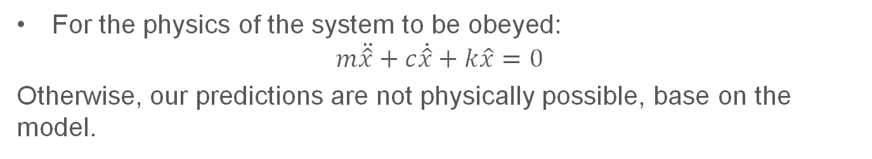
Supervised Learning with Modification
Can we make use of the (expected) system physics, as well as data, to predict system response?
Consider the differential equation of the spring-mass-damper system. The physics tells us something 🤔
For the physics of the system to be obeyed:
$$m\ddot{\hat{x}}+c\dot{\hat{x}}+k\hat{x}=0$$
Otherwise, our predictions are not physically possible, base on the model.
We will add a physics loss to our model!

Slide 6














PINNs and Incorporating Physics Loss
Now that the physics are added to the loss, the architecture changes:
$$\ddot{\hat{x}}(t_{i})$$
$$\frac{d}{dt}$$
$$\dot{\hat{x}}(t_{i})$$
$$\frac{d}{dt}$$
$$+ \\ + \\ +$$
$$t_{i}$$
$$m$$
$$\hat{x}(t_{i})$$
$$L_{phys}$$
$$c$$
$$k$$
$$MSE$$
$$L_{Data}$$
$$x(t_{i})$$

Slide 7







PINN

Slide 8















Algorithm

Slide 9







Extra notes

Slide 10
Pendulum PINN Example
Notes:
Welcome and Introductions

Slide 11
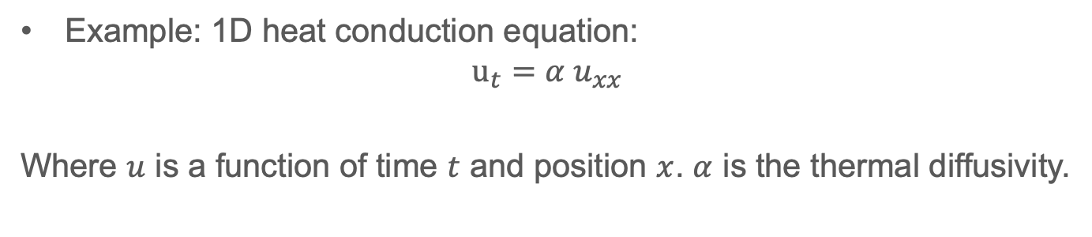
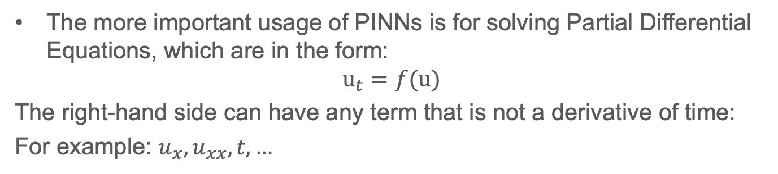

Generalization: PINN for PDEs
The more important usage of PINNs is for solving Partial Differential Equations, which are in the form:
$$u_{t}=f(u)$$
The right-hand side can have any term that is not a derivative of time:
For example: $u_{x}, u_{xx}, t, …$
Example: 1D heat conduction equation:
$$u_{t}=α u_{xx}$$
Where $u$ is a function of time $t$ and position $x$. $α$ is the thermal diffusivity.
$$f(u)$$

Slide 12


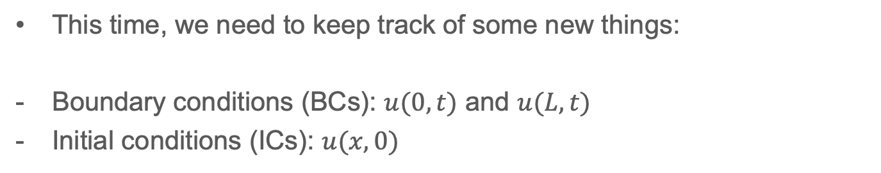

PINNs for PDEs
For a PDE that is 1D in space and is a function of time, the PINN will have time and position as input.
This time, we need to keep track of some new things:
Boundary conditions (BCs): $u(0,t)$ and $u(L,t)$
Initial conditions (ICs): $u(x,0)$
$$x_{i}$$
Thus, we have losses due to ICs and BCs.
$$\hat{u}(x_{i},t_{i})$$
$$t_{i}$$

Slide 13







Losses for PDE PINN

Slide 14
1D Heat Conduction PINN Example
Notes:
Welcome and Introductions

Slide 15
Issues with PINNs
Notes:
Welcome and Introductions

Slide 16
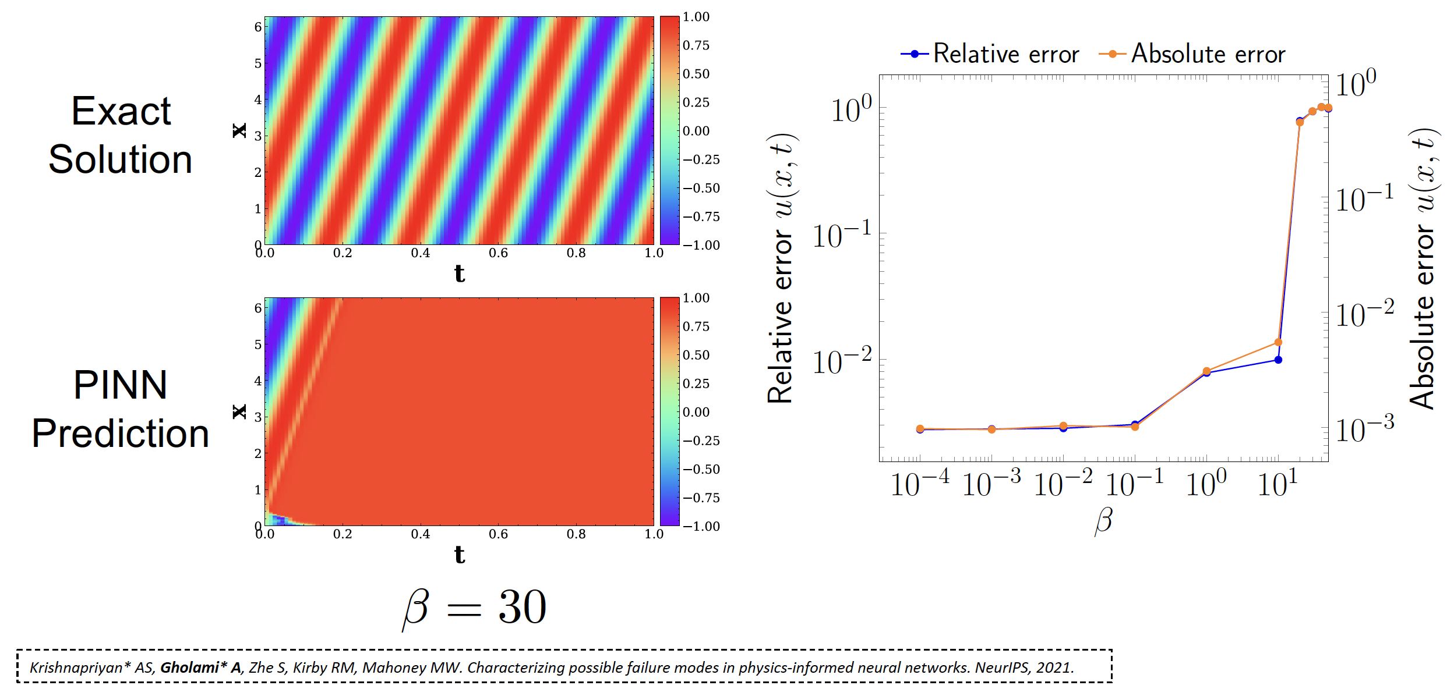
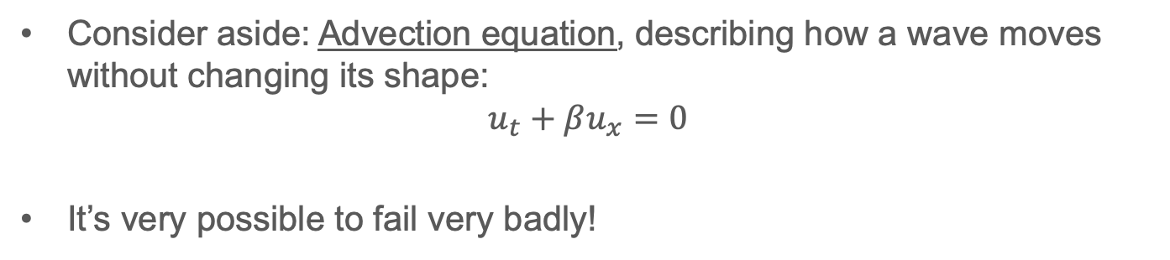
PINNs can fail
Consider aside: Advection equation, describing how a wave moves without changing its shape:
$$u_{t}+βu_{x}=0$$
It’s very possible to fail very badly!

Slide 17
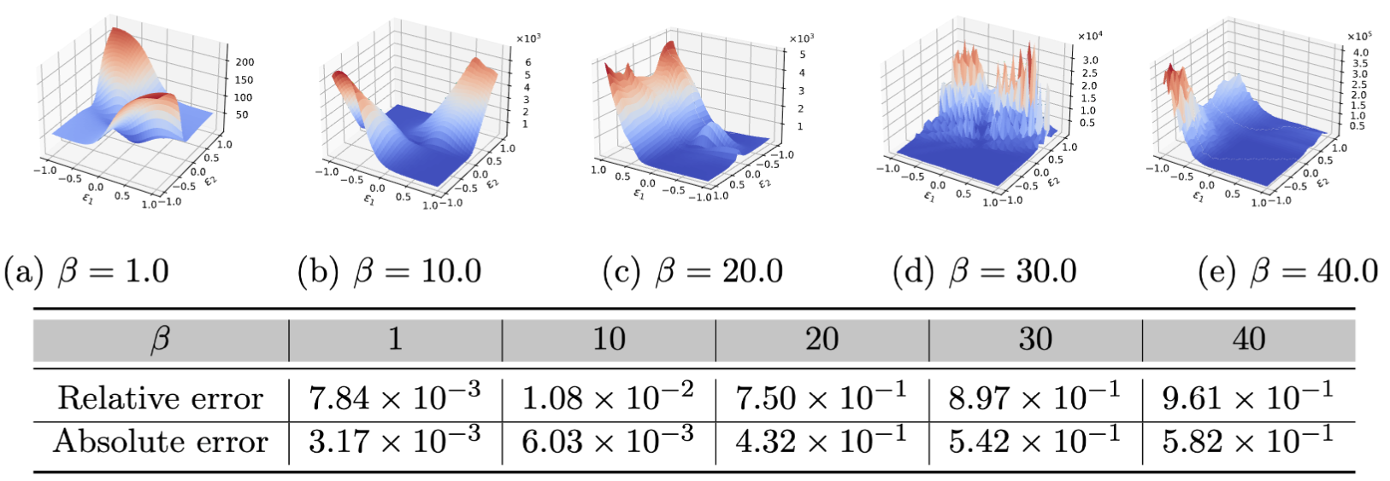
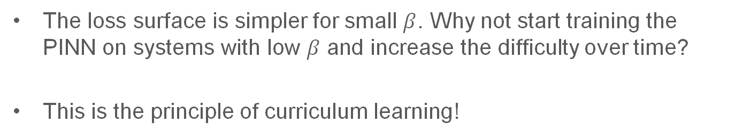
Potential Solution: [1] Curriculum Learning
Sometimes, its preferable to start with a simple system:
The loss surface is simpler for small $β$. Why not start training the PINN on systems with low $β$ and increase the difficulty over time?
This is the principle of curriculum learning!

Slide 18
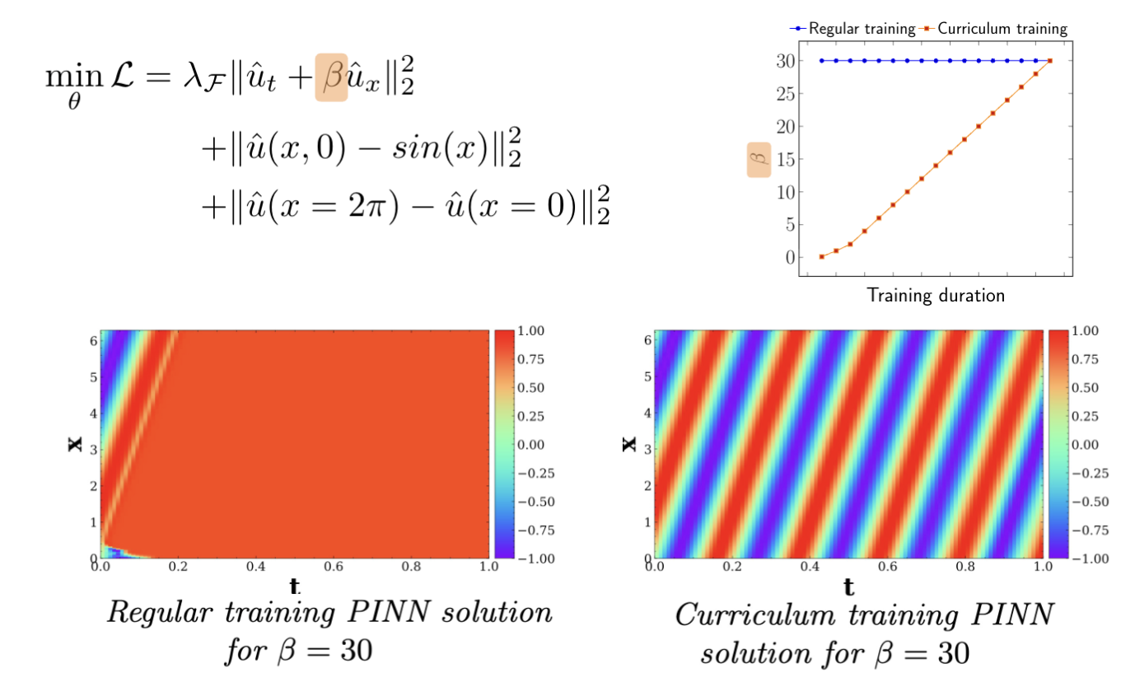
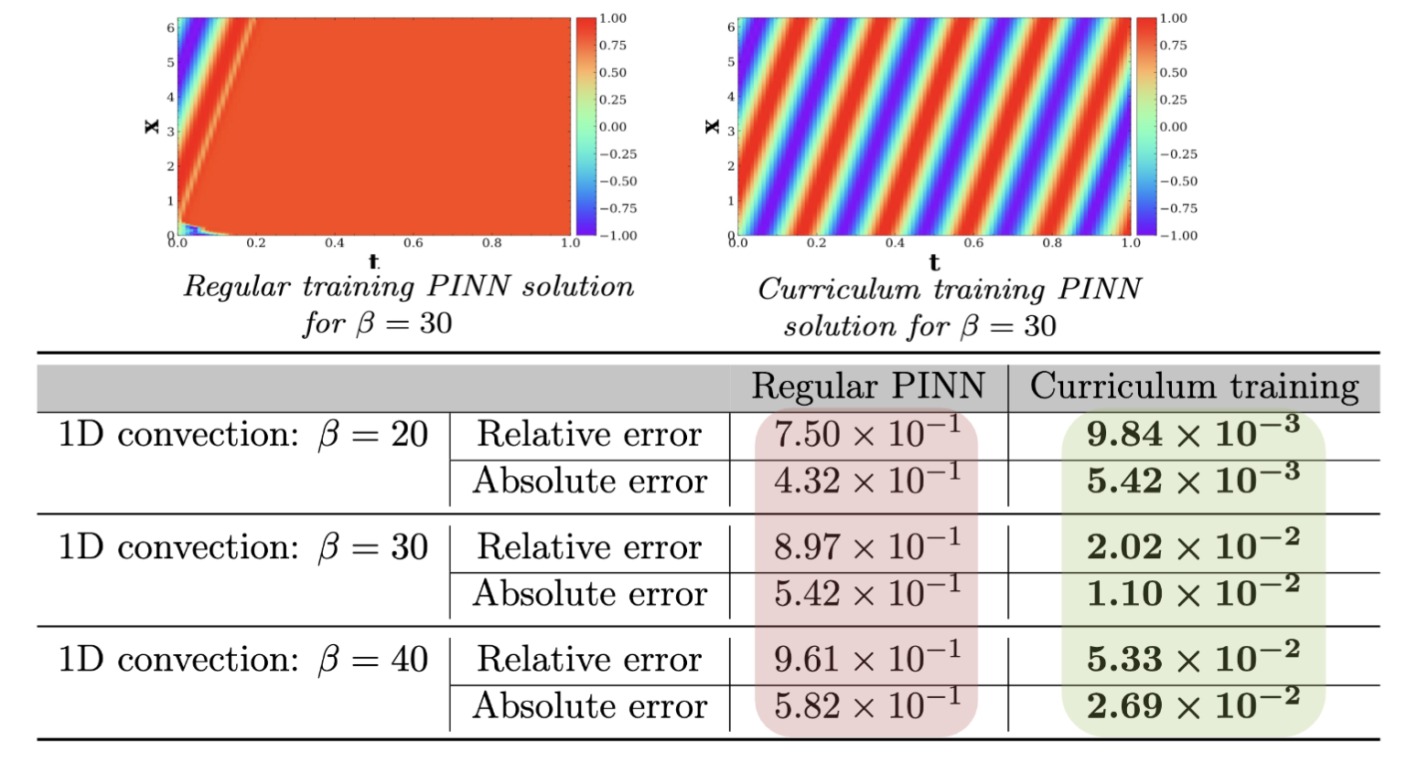
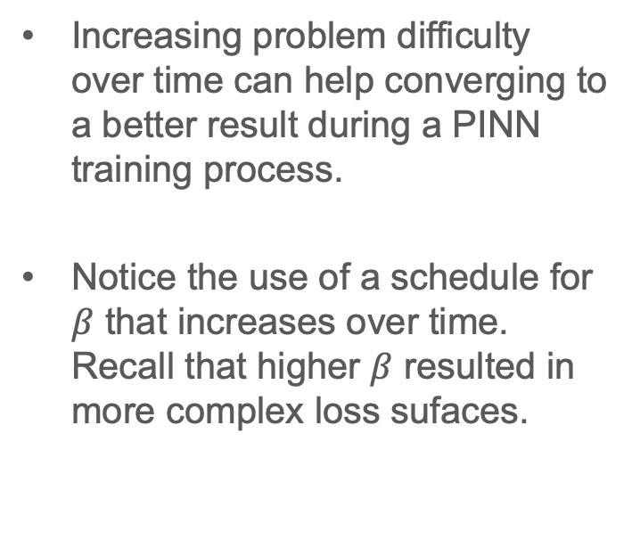
Curriculum Learning
Increasing problem difficulty over time can help converging to a better result during a PINN training process.
Notice the use of a schedule for $β$ that increases over time. Recall that higher $β$ resulted in more complex loss sufaces.

Slide 19
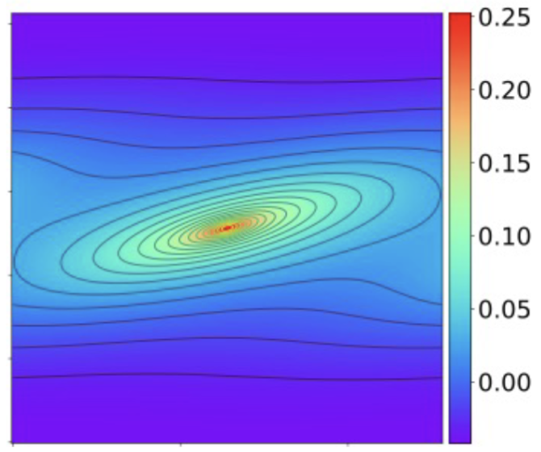
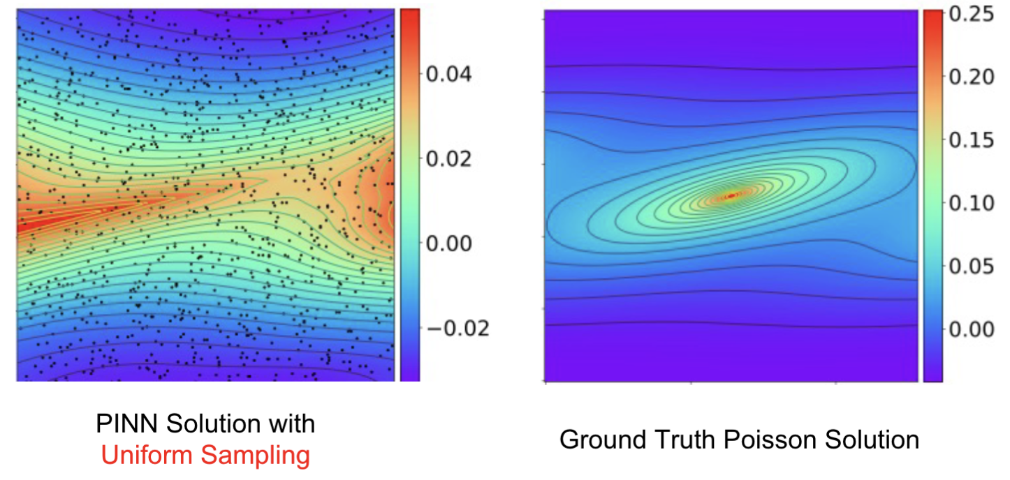
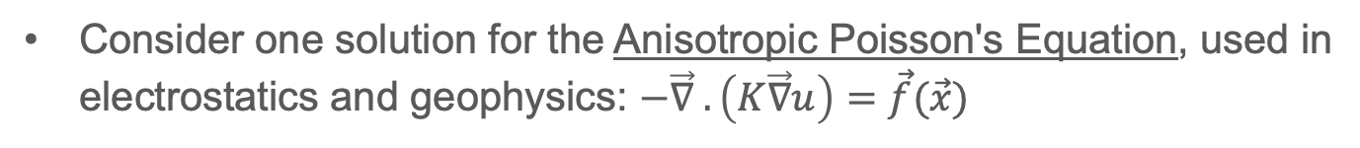
Potential Solution: [2] Non-Uniform Sampling
Consider one solution for the Anisotropic Poisson's Equation, used in electrostatics and geophysics: $−\vec{∇} .\left(K\vec{∇}u\right)=\vec{f}(\vec{x})$
We cannot use infinite number of points from this surface to estimate the physics loss → we sample some points:
If we sample uniformly, we fail to recreate the solution using a PINN …

Slide 20
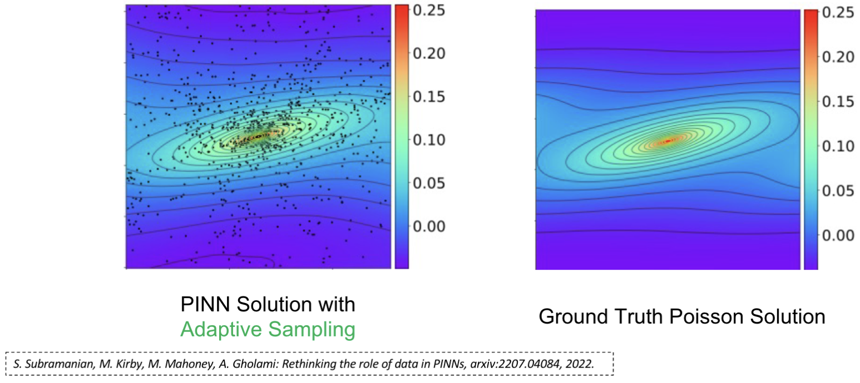
Non-Uniform Sampling
Some features in the solution space may be missed.
If we know about these features, we can disproportionately sample points around these features.
Here, sampling is done using a proxy function.
Requires expert knowledge.

Slide 21
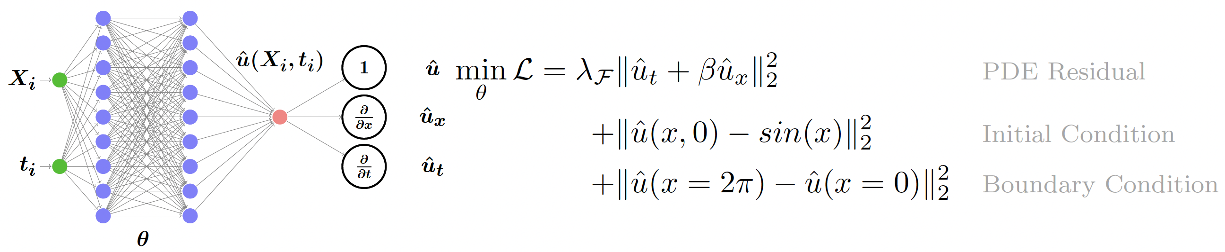
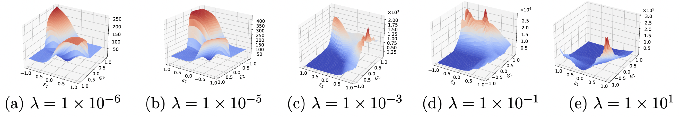
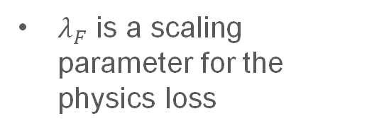
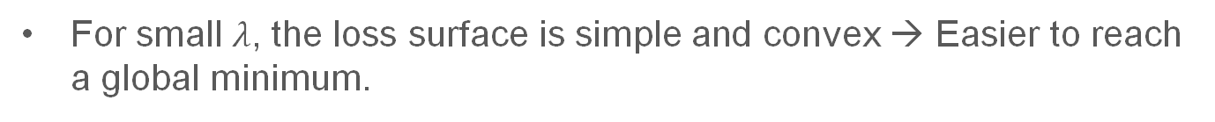
Challenges For PINNs: [1] Loss Function
Suppose a physics (and BC/IC) only loss function
$λ_{F}$ is a scaling parameter for the physics loss
For small $λ$, the loss surface is simple and convex → Easier to reach a global minimum.

Slide 22
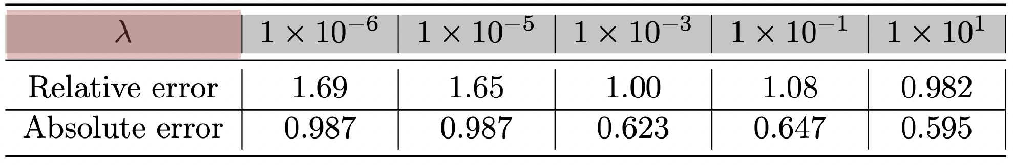
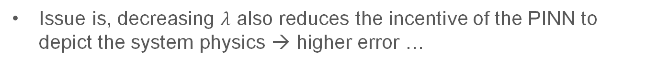
Challenges For PINNs: [1] Loss Function
Issue is, decreasing $λ$ also reduces the incentive of the PINN to depict the system physics → higher error …
For small $λ$, the loss surface is simple and convex → Easier to reach a global minimum.

Slide 23
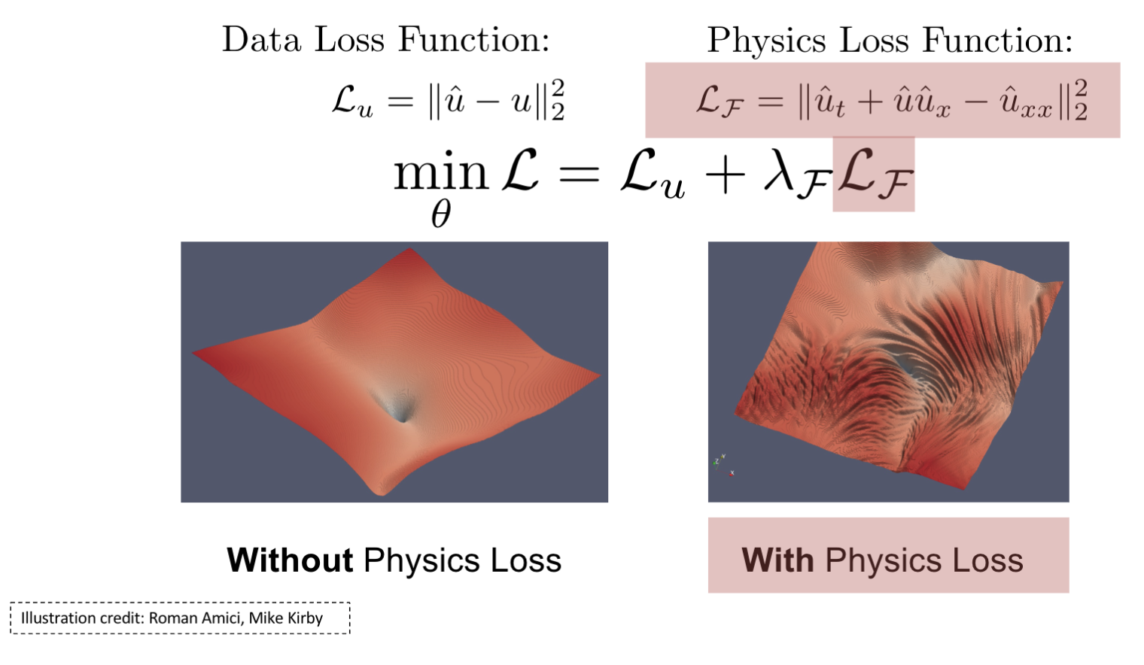
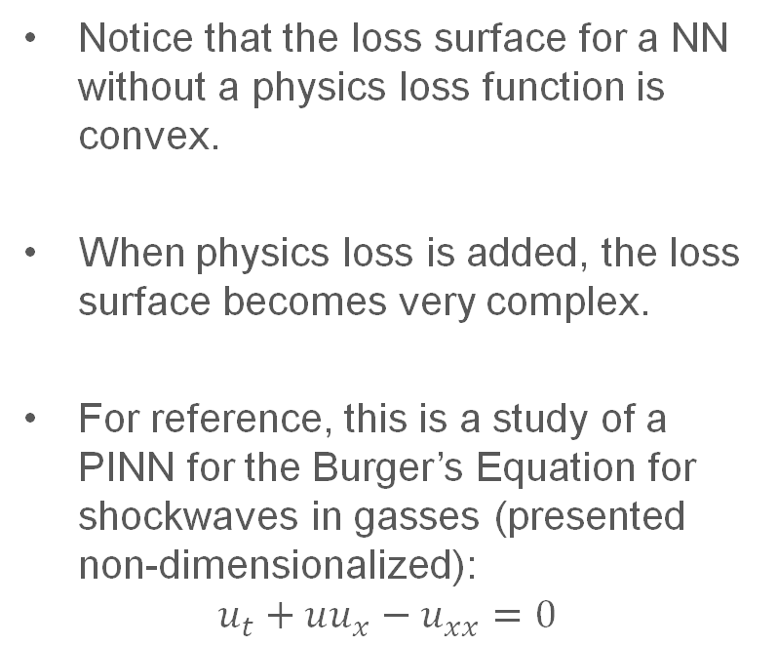
Physics Loss Makes Complex Loss Surfaces
Notice that the loss surface for a NN without a physics loss function is convex.
When physics loss is added, the loss surface becomes very complex.
For reference, this is a study of a PINN for the Burger’s Equation for shockwaves in gasses (presented non-dimensionalized):
$$u_{t}+uu_{x}−u_{xx}=0$$
Remains a challenge

Slide 24
Challenges for PINNs: [2] Architecture
Some of the popular activation functions don’t work for PINNs
ReLU has a zero hessian (second derivative) → does not work for PDEs with higher order derivatives
Alternative activation functions are investigated for PINNs:
Tanh
SiLU
Sine (example: SIREN architecture)
https://arxiv.org/html/2308.04073v1

Slide 25
Conclusion
PINNs can efficiently approximate the solution to ODEs and PDEs
PINNs use physics as a part of their loss function while also allowing experimental data fitting
PINNs may require expert knowledge for training to improve performance
PINN still have some challenges that are being tackled as research problems

Slide 26
References
Slides heavily adapted from: Physics Informed Neural Networks, Lecture for UCSD PHYS 139/239: Machine Learning in Physics, by A. Gholami, S. Subramanian, S. Zhe, M. Kirby, A. Krishnapriyan, K. Keutzer, M. Mahoney. https://jduarte.physics.ucsd.edu/phys139_239/lectures/19_PINNs.pdf
Data-Driven Science and Engineering, Machine Learning, Dynamical Systems, and Control. S. Brunton and J. Kutz, Second Edition. Section 14.5.

Slide 27
Extra notes

